Slide 1
WiFi Booster Impact
Juniora Nalyst
15.05.2026

Slide 2
EDA

Slide 3
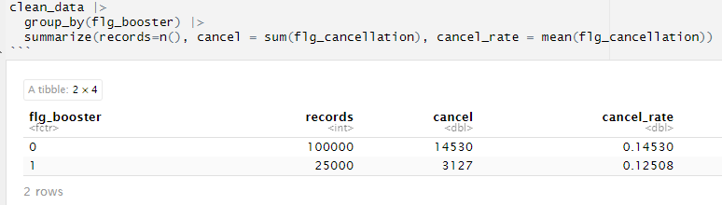

Slide 4
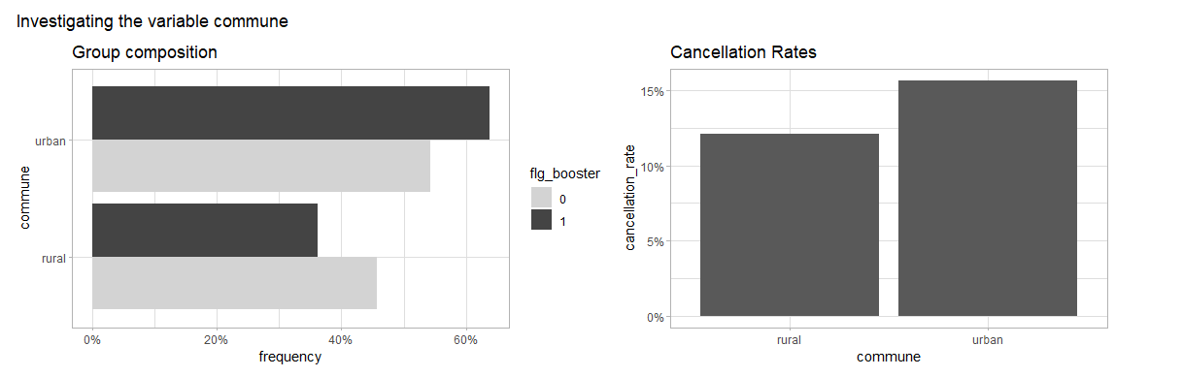



Slide 5
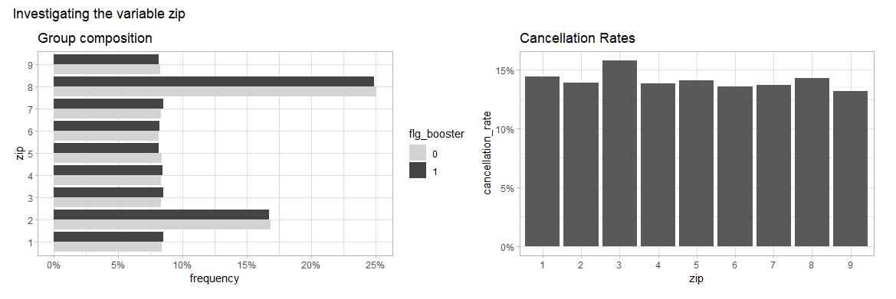


Slide 6
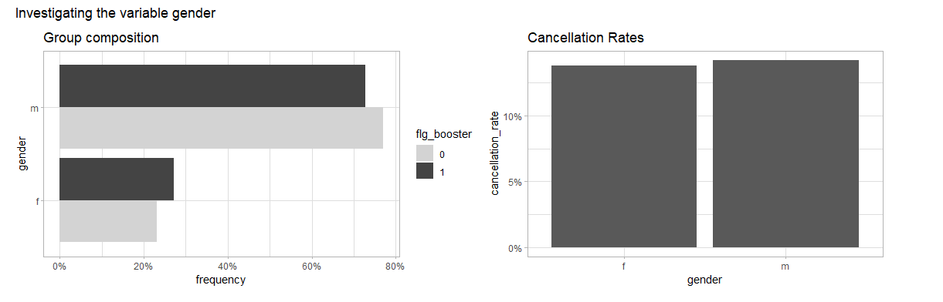

Slide 7
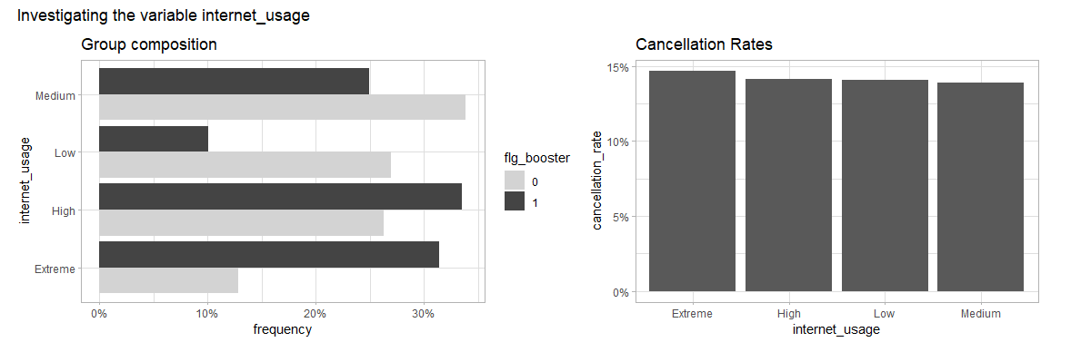

Slide 8
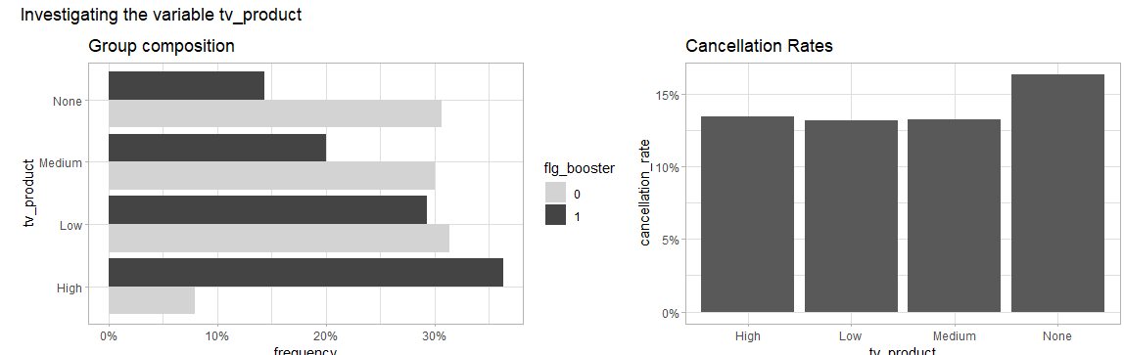

Slide 9
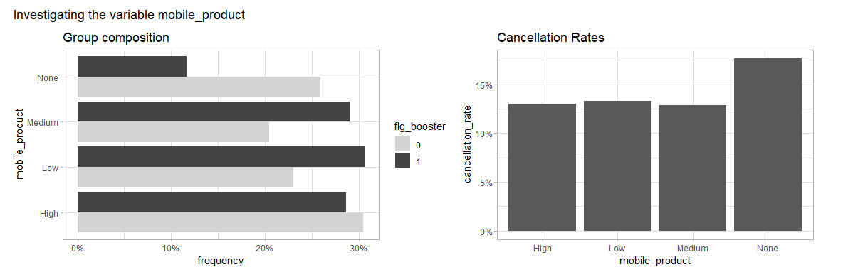

Slide 10
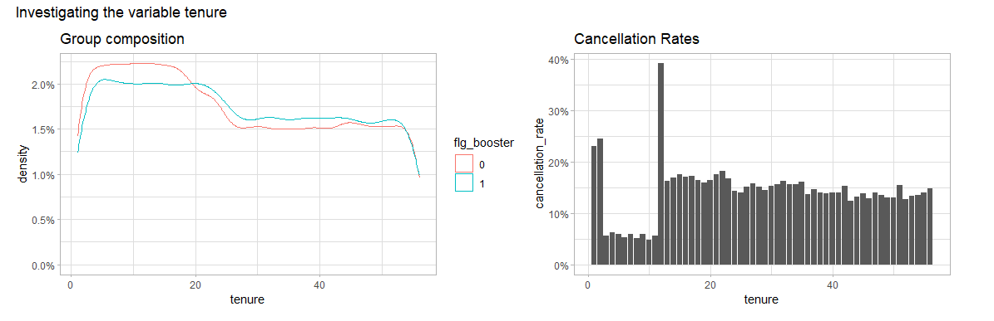

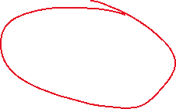

Slide 11
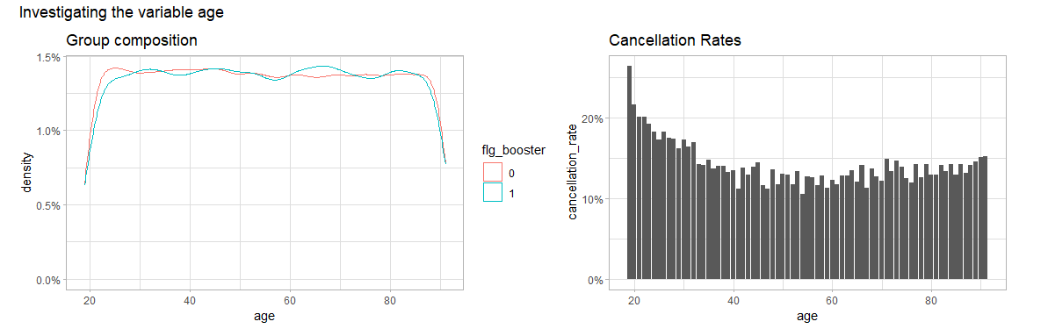
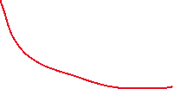

Slide 12
Impact

Slide 13
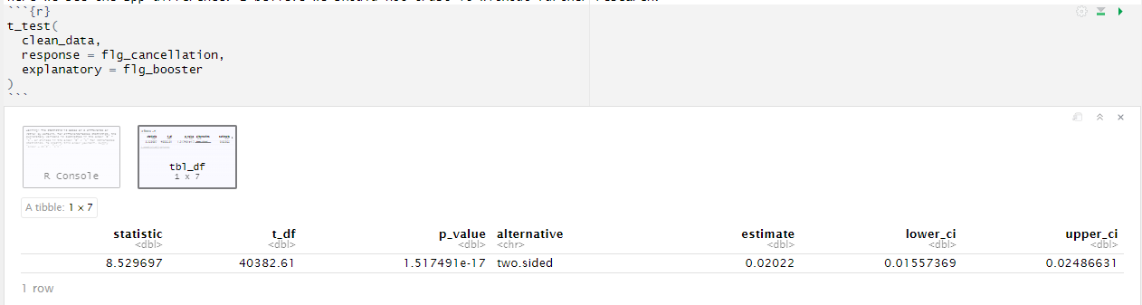

t-test on cancellation

Slide 14
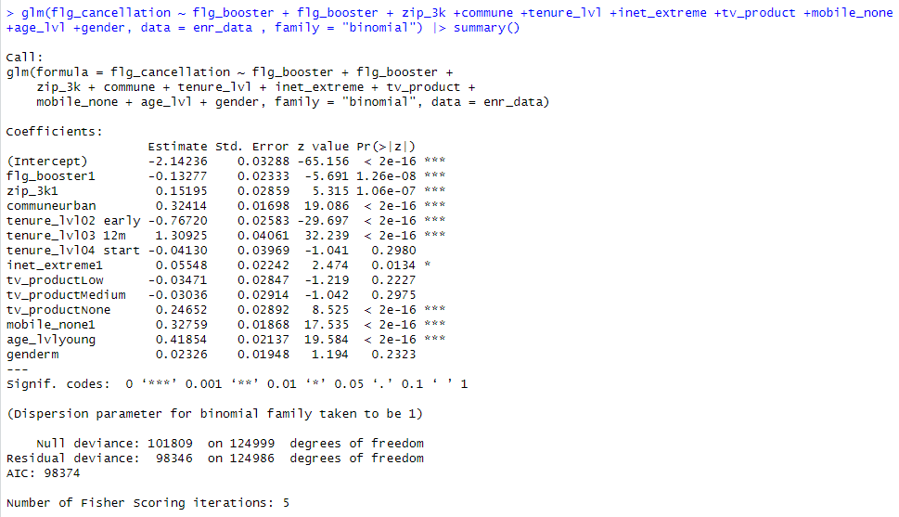
Logistic Regression
14.5% * (1-0.13277) = 12.5748%

Slide 15
Business Case
Assumptions
Customer Base: 1,500,000
Cancellation rate: 14.5%
Value of 1 less cancel: 100 * 18 = 1,800
Cost of 1 Booster: 35
Calculation:
‘No booster’ cancellations: 1,500,000 * 14.5% = 217,500
‘Give booster’ cancellations: 1,500,000 * 12.5% = 187,500
(+) 217,500 - 187,500 = 30,000 * 1,800 = 54,000,000
(-) 1,500,000 * 35 = 45,000,000
9,000,000 net benefit !!

Slide 16
NEXT STEPS
Recommendations
ideally more research is needed before decision
could do a causal analysis, for example
if decision needed immediately, full rollout seems worth CHF 9 million basedo n t-test and log reg both saying 2% less churn with Wi-Fi booster

